Slide 1
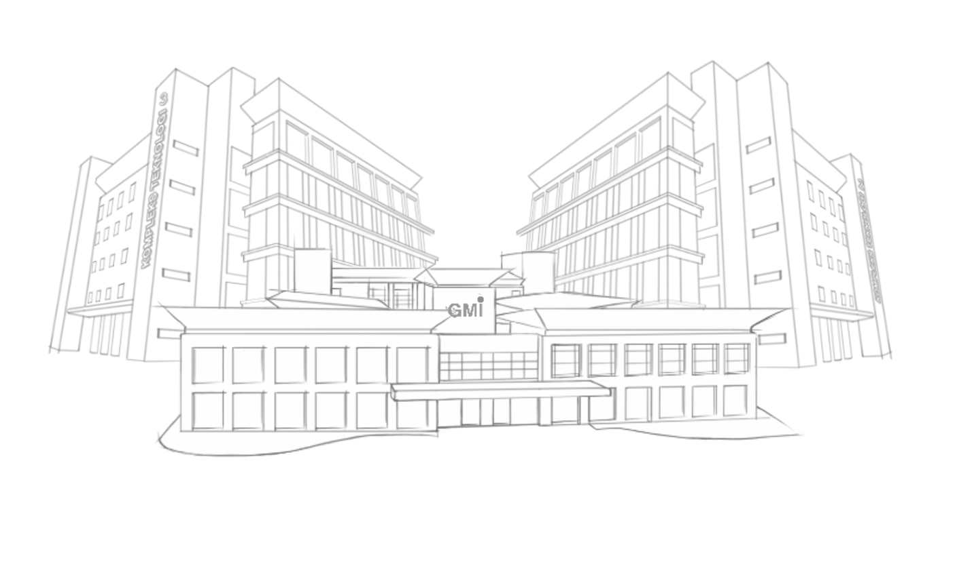



Diploma in Software Engineering
F I N A L Y E A R P R O J E C T
B R I E F I N G

Slide 2



Final Year Project Phases
Phase 1 : Concept
Subject Code
Gather data, identify need and establish goal
Estimate resources, identify alternative and obtain approval
IEP 0722 Project Proposal
2 credit
Software Engineering
Phase 3 : Implementation (FYP2)
Phase 2 : Development
Do coding and execute the project.
Do quality checking
Detail Proposal, master plan & present proposal, obtain approval

Slide 3

FYP PROPOSAL
INDIVIDUAL PROPOSAL (Submit to Supervisor)
SUPERVISOR TO ADVISE – (Title & Difficulty level)
PLAN WEEKLY MEETING WITH SUPERVISOR.
FINALISE PROPOSAL TITLE – (Group members)
SUBMIT GROUP PROJECT BRIEF TO SUPERVISOR
PRESENT GROUP PROJECT BRIEF TO VERIFIERS FOR PRE-APPROVAL
PREPARE PROPOSAL DOCUMENTATION
PRESENT PROPOSAL

Slide 4
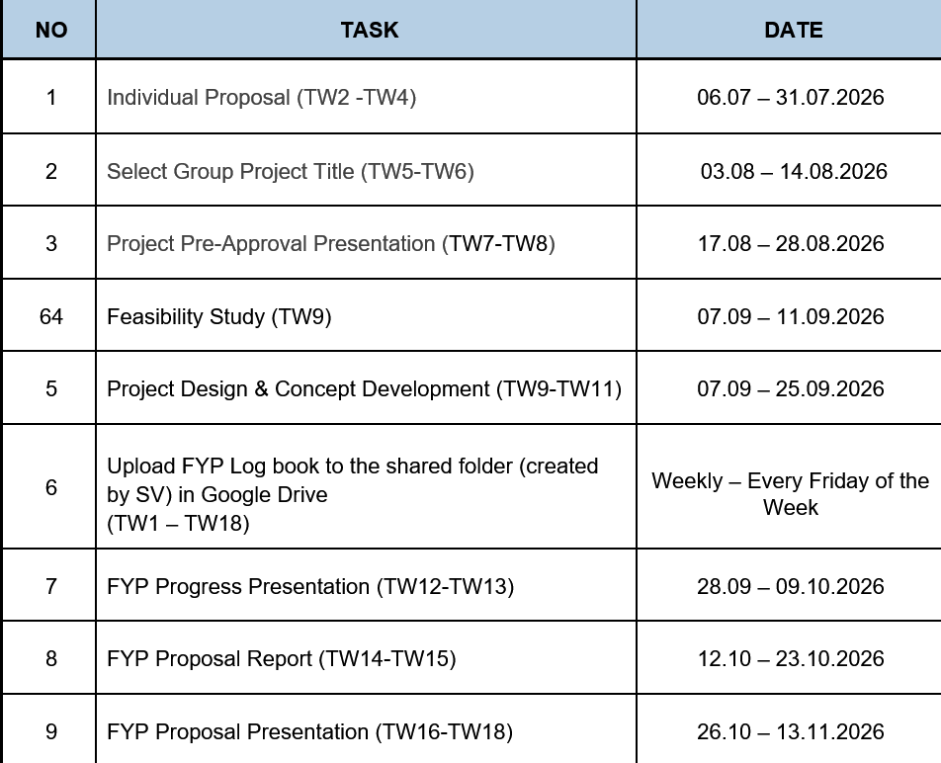

FYP01 DEADLINES

Slide 5
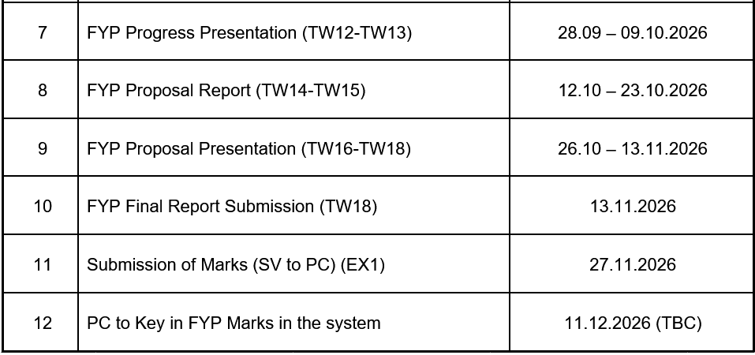
FYP01 DEADLINES

Slide 6
Final Year Group Project
Select a Leader
Leader’s Criteria
Good communication skills
High Responsibility
Motivating the team
Good planning skills (Plan project schedule )
Make sure all team members actively participate
2. Communicate and teamwork among group members. Without teamwork the all group members might FAILED the FYP

Slide 7
3. Set (~ 3 hours ) per week ( a group of 4 students)
Set (~ 4 hours ) per week ( a group of 5 students)
Meet up with supervisors/ concern TTO , to discuss about project progress. (must have written evidence- LOG BOOK).
4. All activities must be recorded
Log into LOG BOOK, all LOG BOOK must updated daily (at least weekly) and to be acknowledged by supervisor.
Each group have to ensure the logbook is always available and accessible when required.

Slide 8
FYP SUPERVISOR
ALL STUDENTS WILL REPORT THE UPDATES TO RESPECTIVE SUPERVISOR REGULARLY
STUDENTS MUST PRO-ACTIVE
SUPERVISOR JUST PROVIDE GUIDANCE.
MOST OF THE FYP MARKS ARE GIVEN BY SV (70%)

Slide 9
Project Proposal
Each students must come up with their own project proposal.(Individual Proposal).
All Student must be able to do own preliminary research on engineering technology project.
Individual project proposal REPORT must be submitted to supervisor for assessment

Slide 10
Group Project Selections
Students are required to choose the best project proposal among their group members. (consult FYP supervisor).
Choose for the most feasible (technology, time & budget) and suitable level of difficulty.
Avoid non-value (with no commercial value) project

Slide 11
Example of non profit and non value project.
Automatic Electric White Board Cleaner – using electronic & mechanical mechanism such as housing, dust chamber , power switch a DC motor and etc. that might cost > RM 500 BUT no value because of its purpose is just to erase the white board.
Cost Value

Slide 12
Group Proposal. How to Start ?
Decide the group project title.
Feasibility Study - of industrial problem statements and proposed solutions / improvements.
What you plan to achieve in your project?
Example : cost required and value to be accomplished.
A well-designed feasibility study should provide a historical background of the project, description of the product and details of the operations.

Slide 13
Project Proposal Content
Stage 1 - Background
Introduction
Literature Review
Project Objective
Divided into 3 stages
Stage 2 - Methodology
SDLC Process (First phase until Testing)
Sofware Requirement Specification (UCD, SD, AD, CD)
Project Specification (Hardware & Software Specification)
Stage 3 - Hypothesis
Project Schedule & Budget Plan
Expected Outcomes
Conclusions

Slide 14
FYP BUDGET
PURCHASE EQUIPMENT
    RM1000/STUDENT
COMMON ITEMS
  RM1000/GROUP
PETTY CASH
  RM500/GROUP

Slide 15
ALL THE BEST
Kindly consult project supervisor or Program Coordinator for more information.

Slide 16
Q & A
Thank you.

